Slide 1


HelloMaid
Project Group No:- 01
Group Members:- Project Guide:- Suraja PK
Aditya Palkar
Abhijit Wagh
Aditi Pawar
Aditya Wath
Aditya Deshmukh

Slide 2

Agenda
Project Introduction
Project Architecture
Technology Platform used for Project
User Roles and Responsibility
Division of Work within Team
Future Extensions if any
Conclusion

Slide 3
Project Introduction
Purpose of the Project
This Maid Booking project provides an Online Platform for the customers to book maid online on the basis of categories given in project.
Need of Project
Whenever we visit some places and end up finding no suitable maid for work and with extra charges. We came up with solution of providing maid online booking to customer in terms of Cooking,Cleaning,Washing categories.

Slide 4
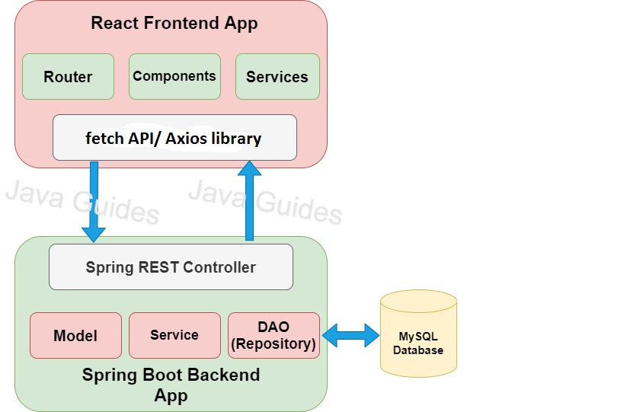

Project Architecture

Slide 5
Technology platform used for project
Technologies used :
Front end : HTML, CSS, JavaScript, React JS
Middle tier : Spring boot, Hibernate
Database : MySQL
Reason for selecting specific technologies
React JS :
-- The React basically allows developers to utilize individual parts of their application on both client-side and the server-side, which ultimately boosts the speed of the development process.
- Compared to other frontend frameworks, the React code is easier to maintain and is flexible due to its modular structure.
- The core of the framework offers a virtual DOM program and server-side rendering, which makes complex apps run extremely fast.

Slide 6


Spring boot
Its main purpose is RAD(Rapid Application Development) i.e. reducing development time as much as possible.
It quickly releases the app in production environment and follows some development model ‘defaults opinionated approach’ i.e. spring boot will configure few things automatically.
Spring boot comes with embedded tomcat server so there is no any context root and hence application is deployed as self deployable unit.
MySQL
MySQL is globally renowned for being the most secure and reliable database management system used in popular web applications like WordPress, Drupal, Joomla, Facebook and Twitter. The data security and support for transactional processing that accompany the recent version of MySQL, can greatly benefit any business especially if it is an eCommerce business that involves frequent money transfers.
MySQL offers unmatched scalability to facilitate the management of deeply embedded apps using a smaller footprint even in massive warehouses that stack terabytes of data. On-demand flexibility is the star feature of MySQL. This open source solution allows complete customization to eCommerce businesses with unique database server requirements.

Slide 7

User Roles & Responsibilities
User Roles
Admin, User, Maid
Responsibilities for each user
Admin: Maid Registration, checking details of customer and Maid Booking and doing CRUD operation of Maid Role.
User: User Registration, Updating Profile, Booking of Maid .
Maid: Maid Registration , Updating Profile.

Slide 8

Future extension if Any
Will add more categories in worklist of Maid.
Will add another functionality of Maid Blacklisting.
Admin can remove Blacklist maids from Application.
Slots management should be done in proper way.
Will add online payment functionality, e.g. UPI’s.

Slide 9

Conclusion
Learnt the flow of how a project works.
Initially have so much brainstorming about the project.
Got to know how many processes are going on inside the project.
Working with many technologies and making them work together.
Got to know about various issues that can occur while development and how to resolve them.
For several years we saw many websites but now we know how everything works.
It was a great experience to work with different technologies and teammates.

Slide 10


GitHub Link
https://github.com/AdityaPalkar/HelloMaid

Slide 11


